Slide 1

SafeEscape App
Wireframe presentation
Version 0.1.2
Rick Larsen

Slide 2
Features of the SafeEscape App
Before an emergency
Users can opt in to save their identifying information
Users can submit fire exit locations
Users can vote to confirm other submitted locations (helps with fraudulent/false submissions)
During an emergency
Users can send their location to first responders to help first responders locate or account for them
Users can send / receive messages from first responders

Slide 3

Open the app
Landing page

Slide 4
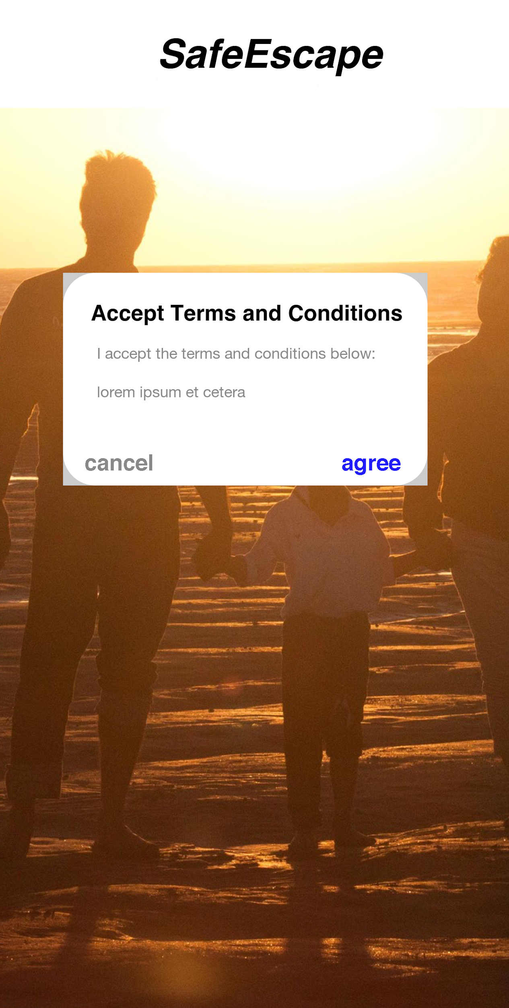
Accept terms and conditions
First time app is opened

Slide 5
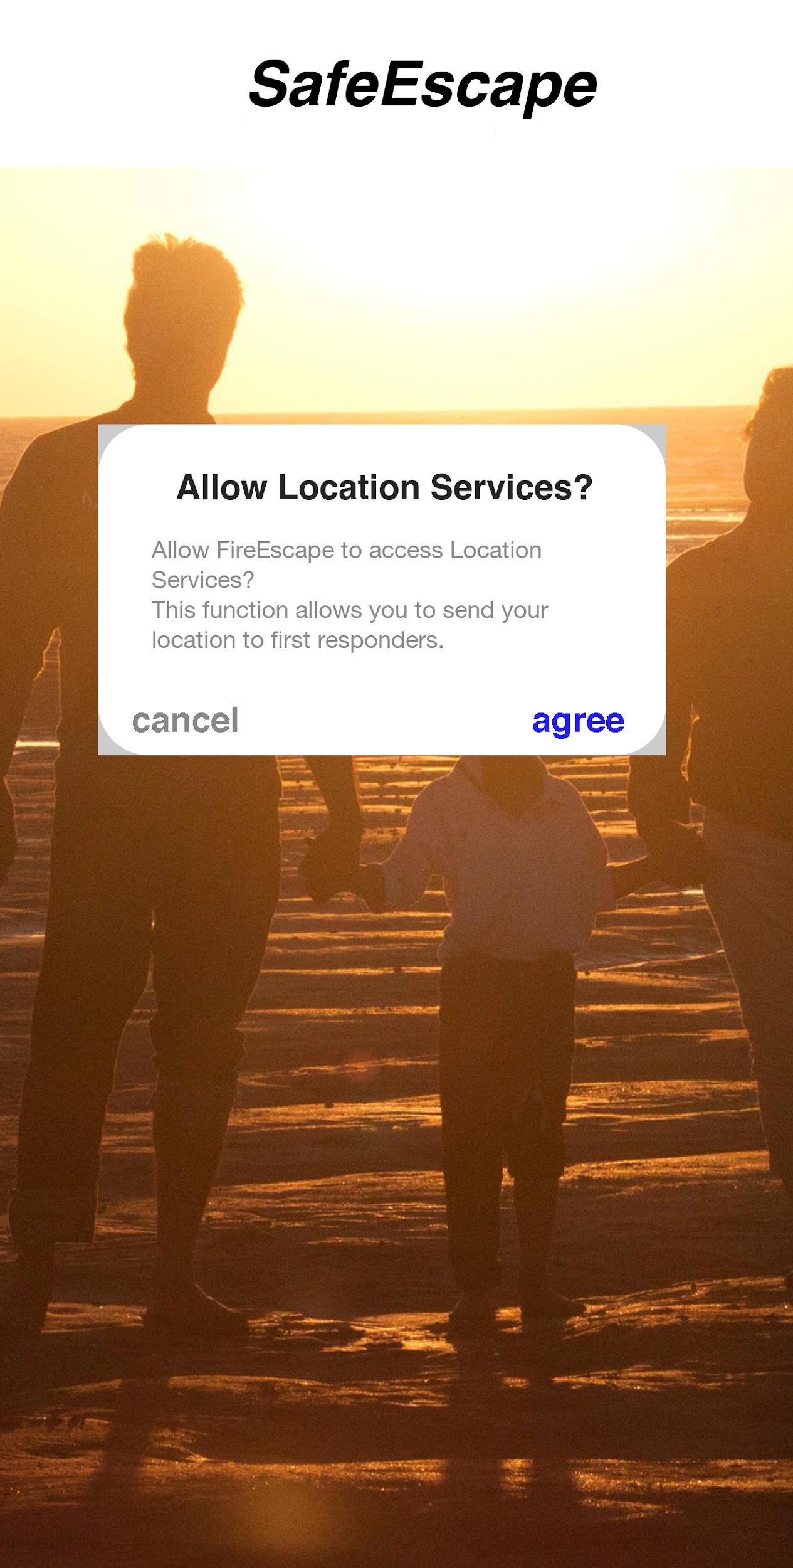
Accept location Services
User is prompted to allow to access location data while using the app. This is important to send location data to first responders. (Local police and fire must also be registered)

Slide 6
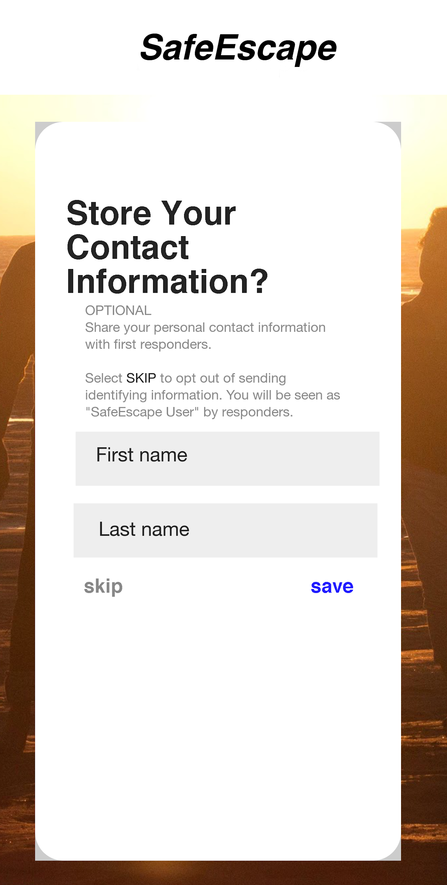
Optional: Enter Contact information
Enter identifying information to send to first responders.
Or
skip

Slide 7
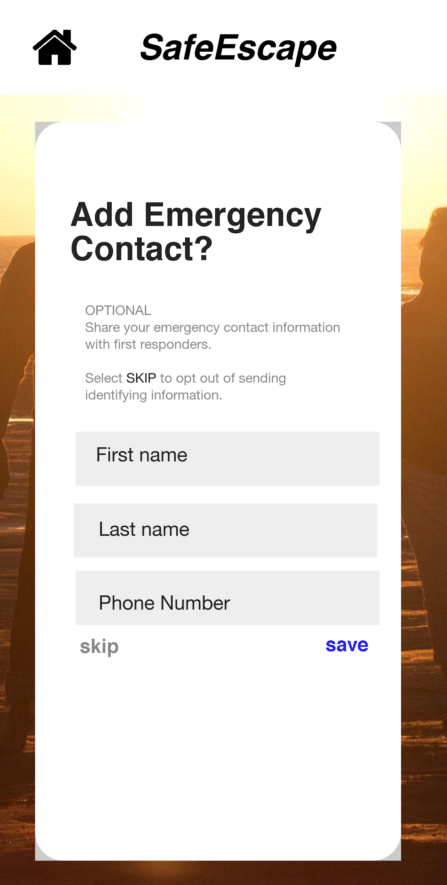
Add an Emergency Contact
OPTIONAL:
Users can add an emergency contact or skip and add later from the account details screen.

Slide 8
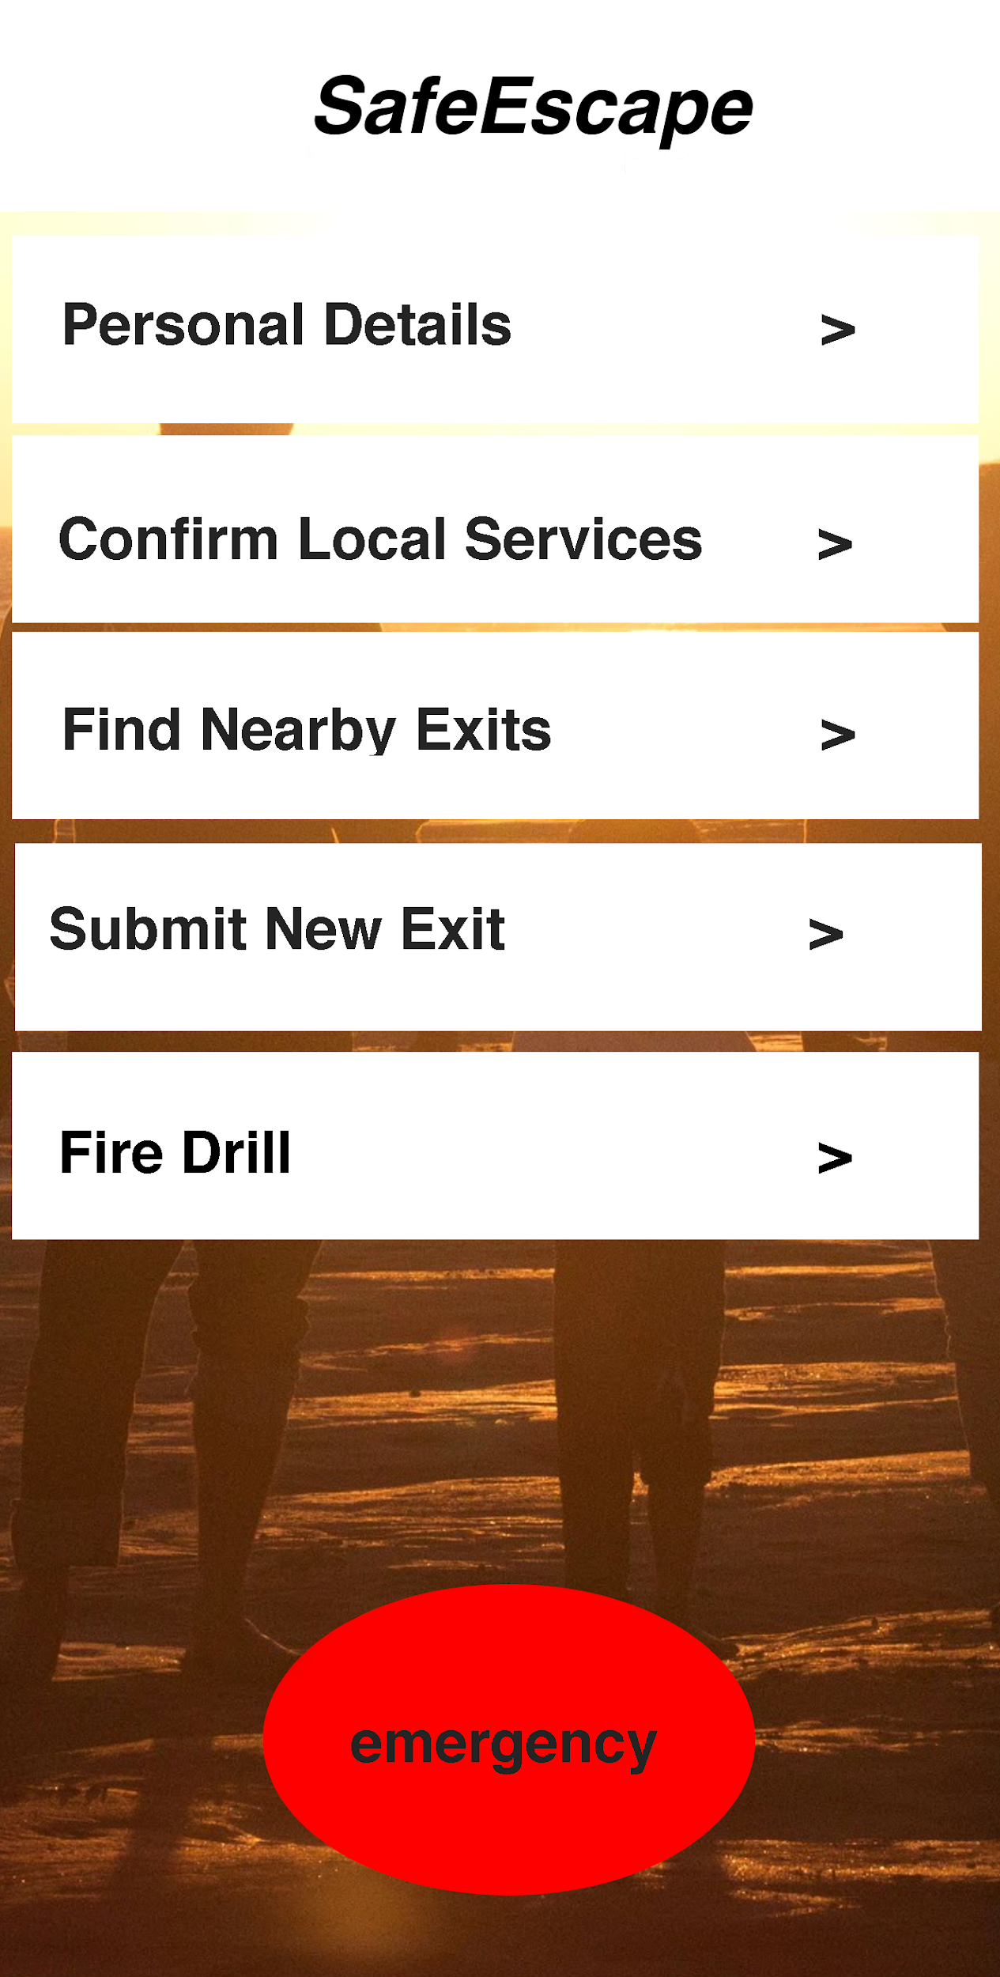
Home screen
Choices include:
Personal details
Confirm local emergency services
Find nearby exit locations
Submit new Emergency Exit location
Fire Drill
Contact emergency services

Slide 9
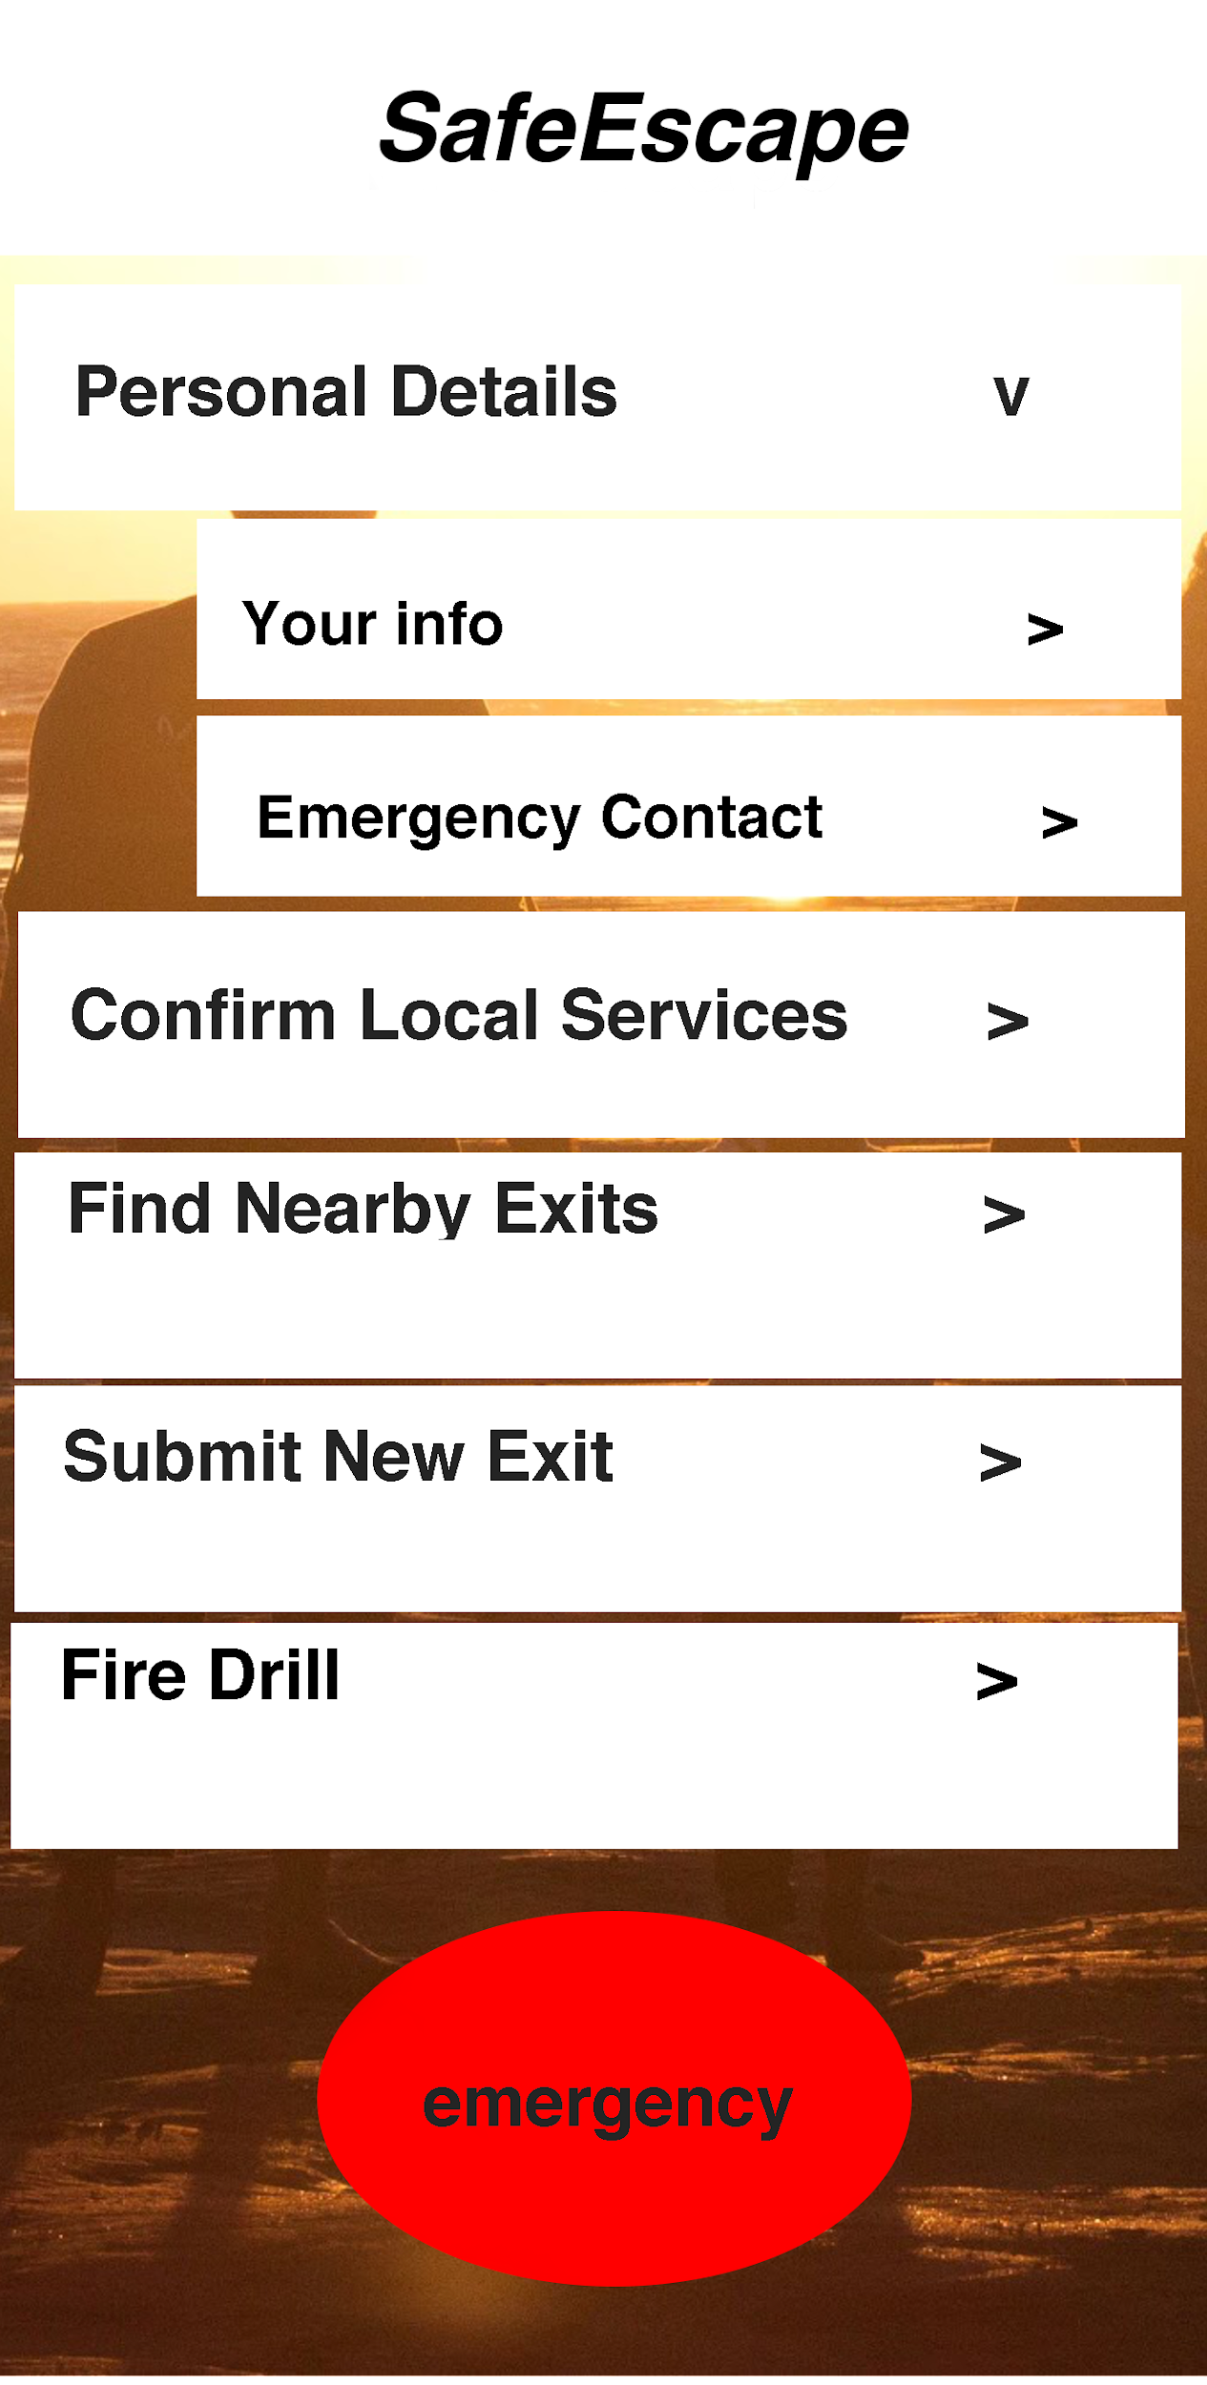
Personal Details (expanded)
Select either You or Your Emergency Contact

Slide 10
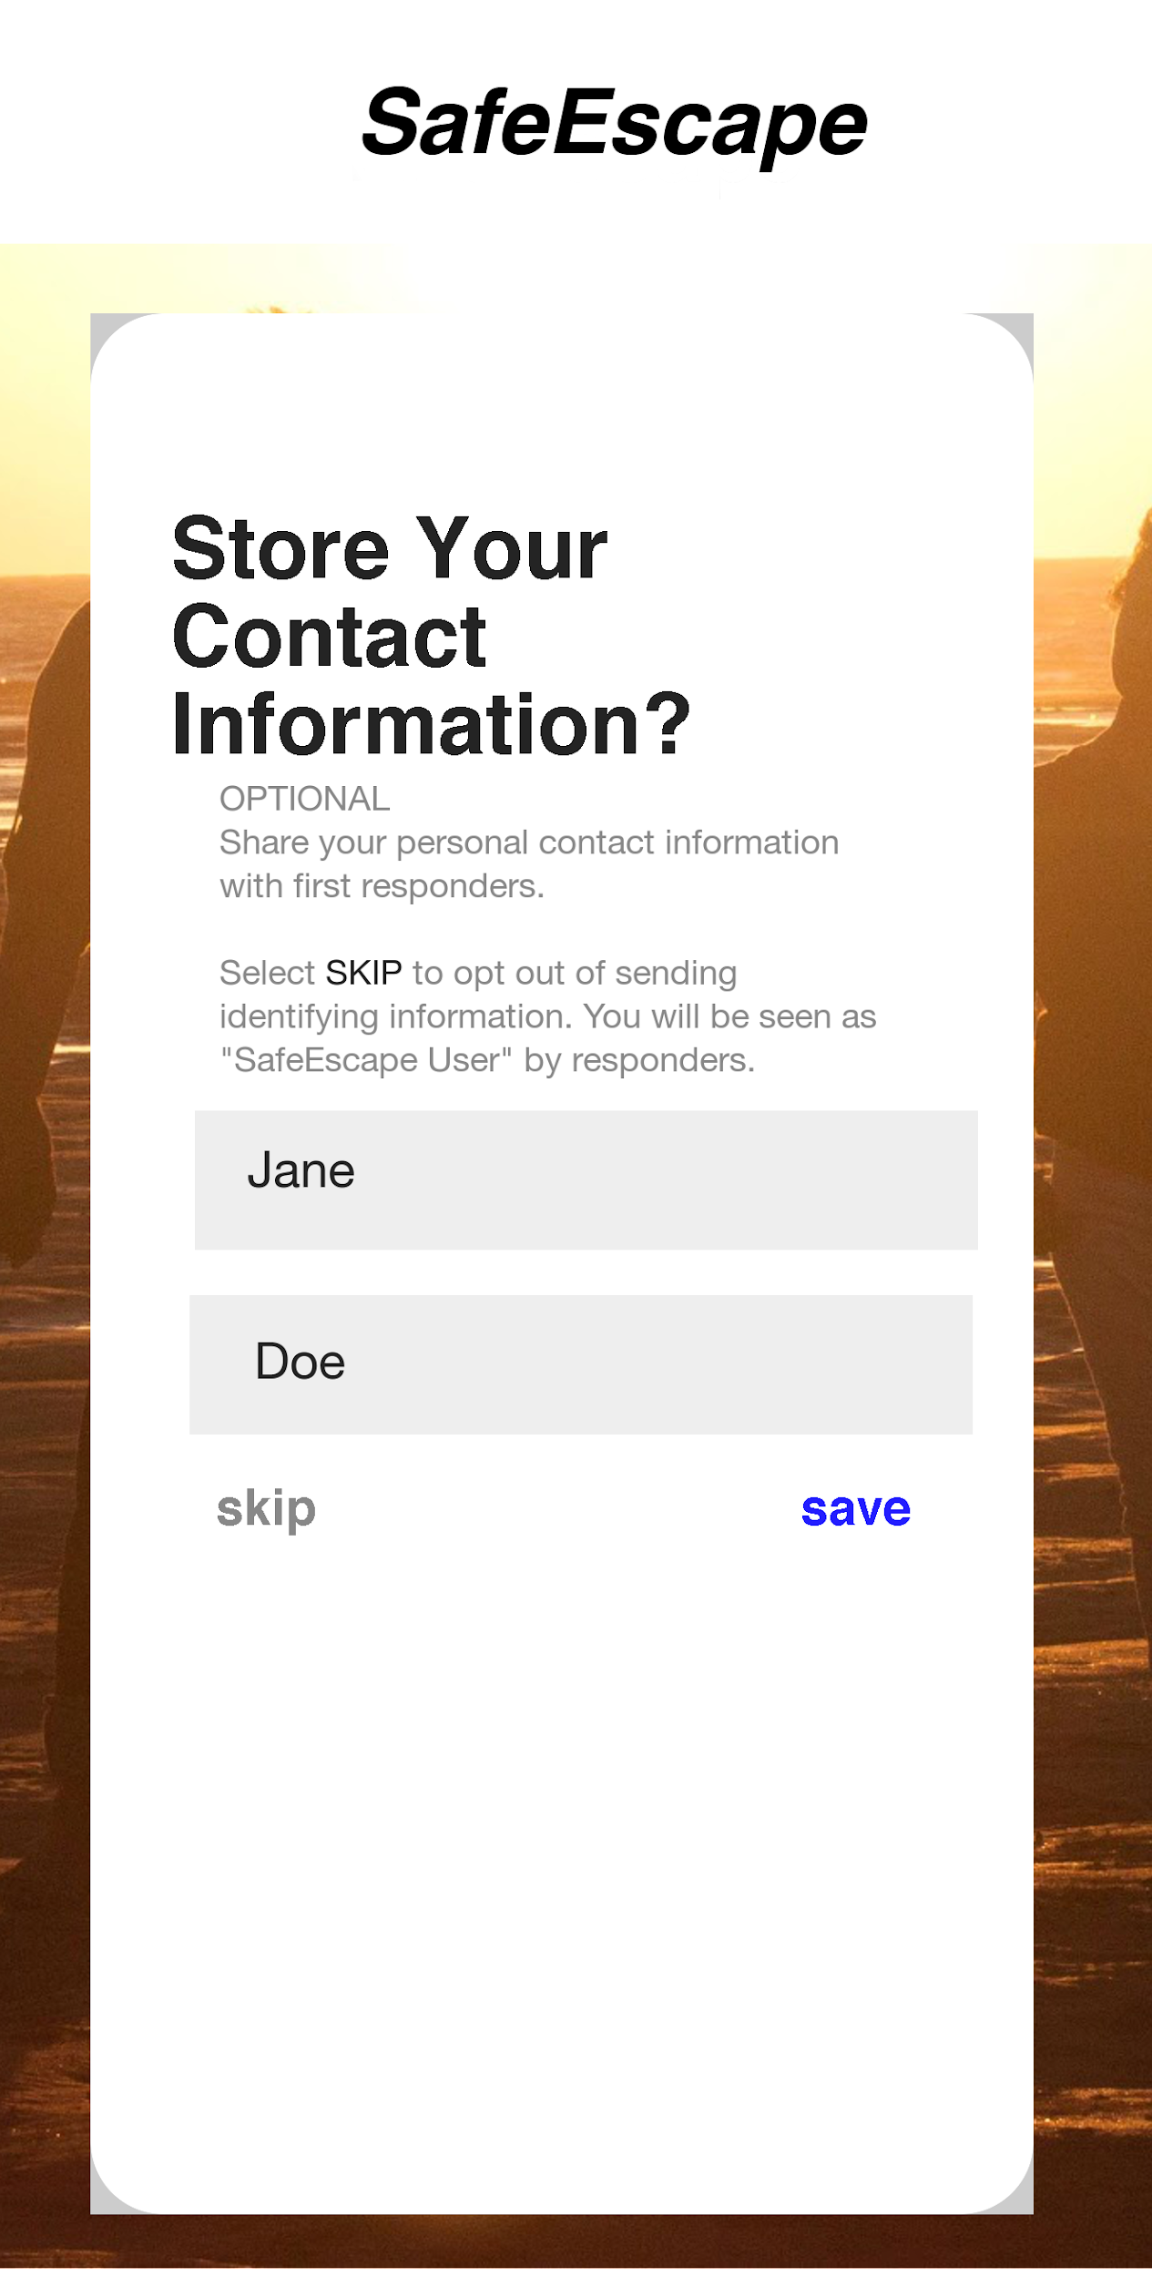
About You
Optional:
Self:
First Name
Last Name
Enter or Cancel

Slide 11
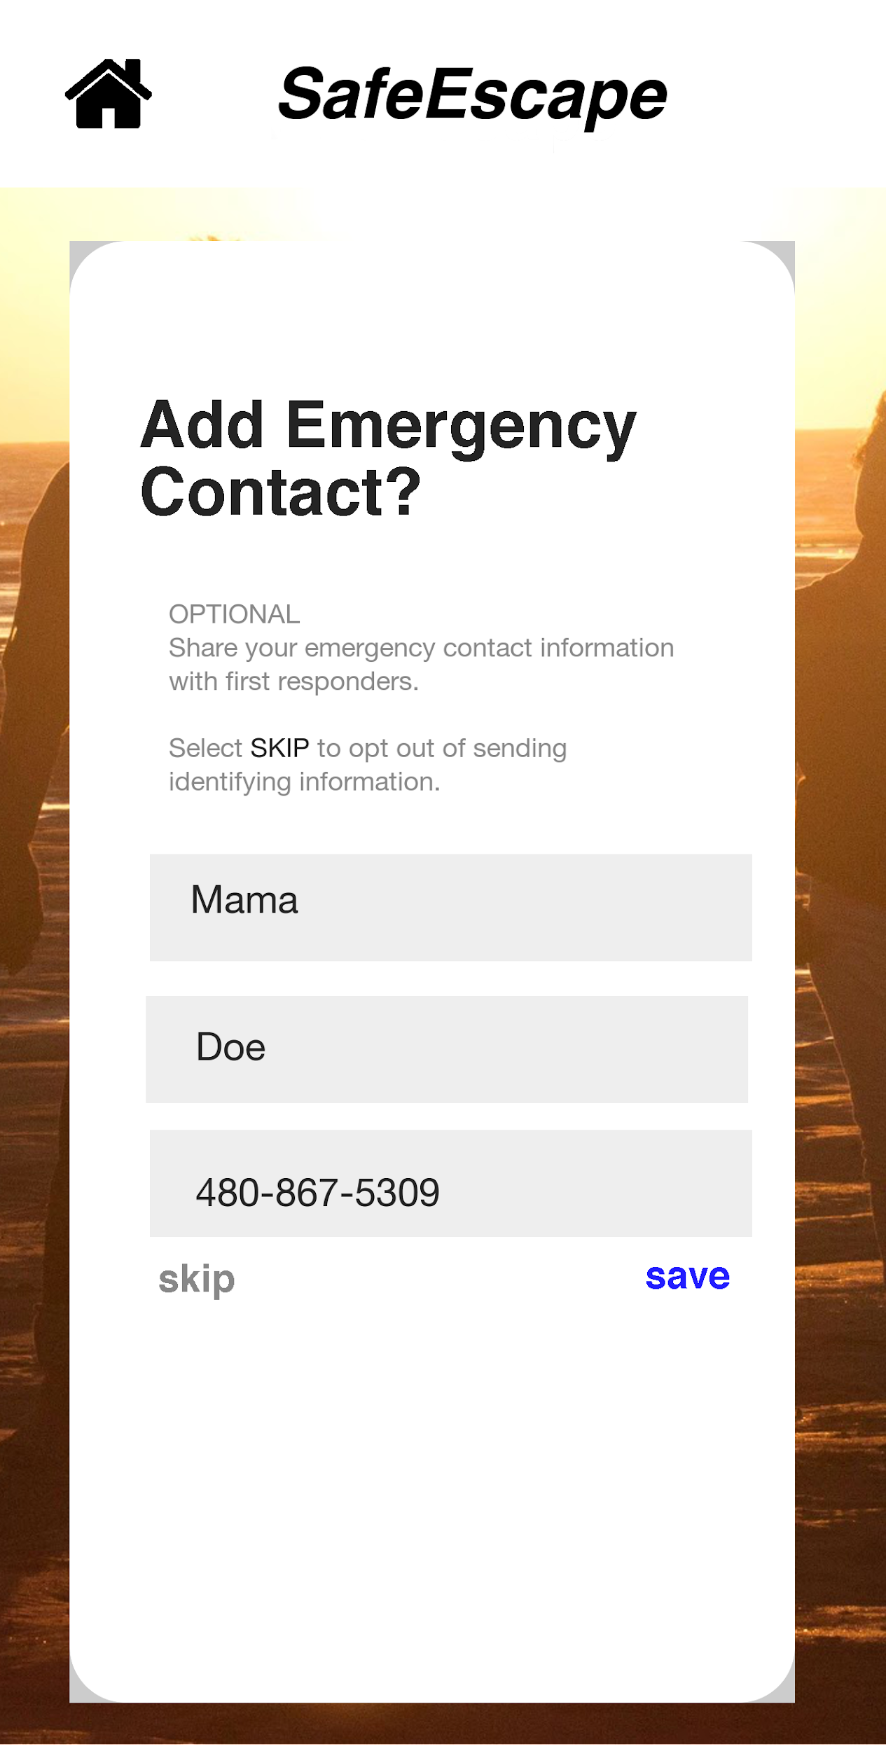
Emergency Contact
Optional:
Emergency Contact info:
First Name
Last Name
Phone Number
Emergency contact
Enter or Cancel

Slide 12
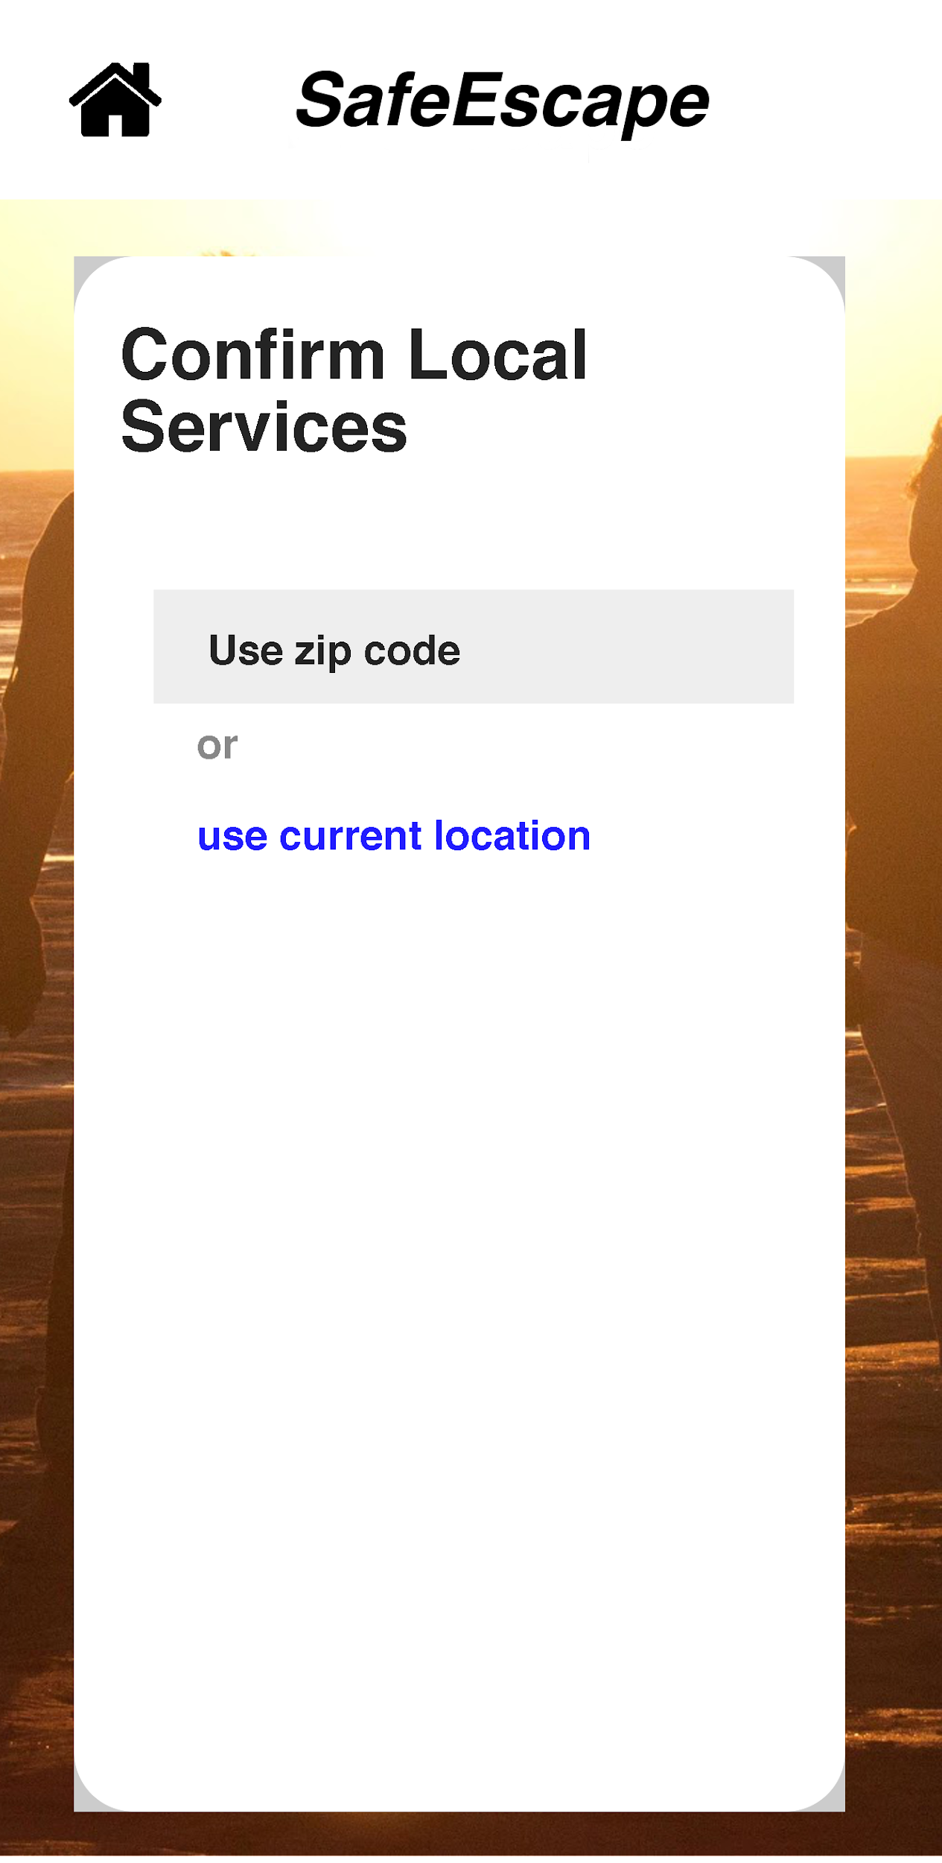
Confirm Local Emergency Services
Enter zip code
Or
Use current location
To confirm if local fire/police are registered with FireEscape Services
If services found
No services found

Slide 13
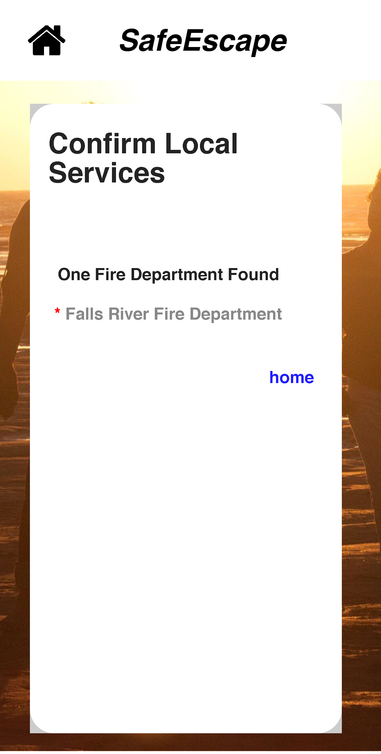
Local Services available
Click Home to return to home screen

Slide 14
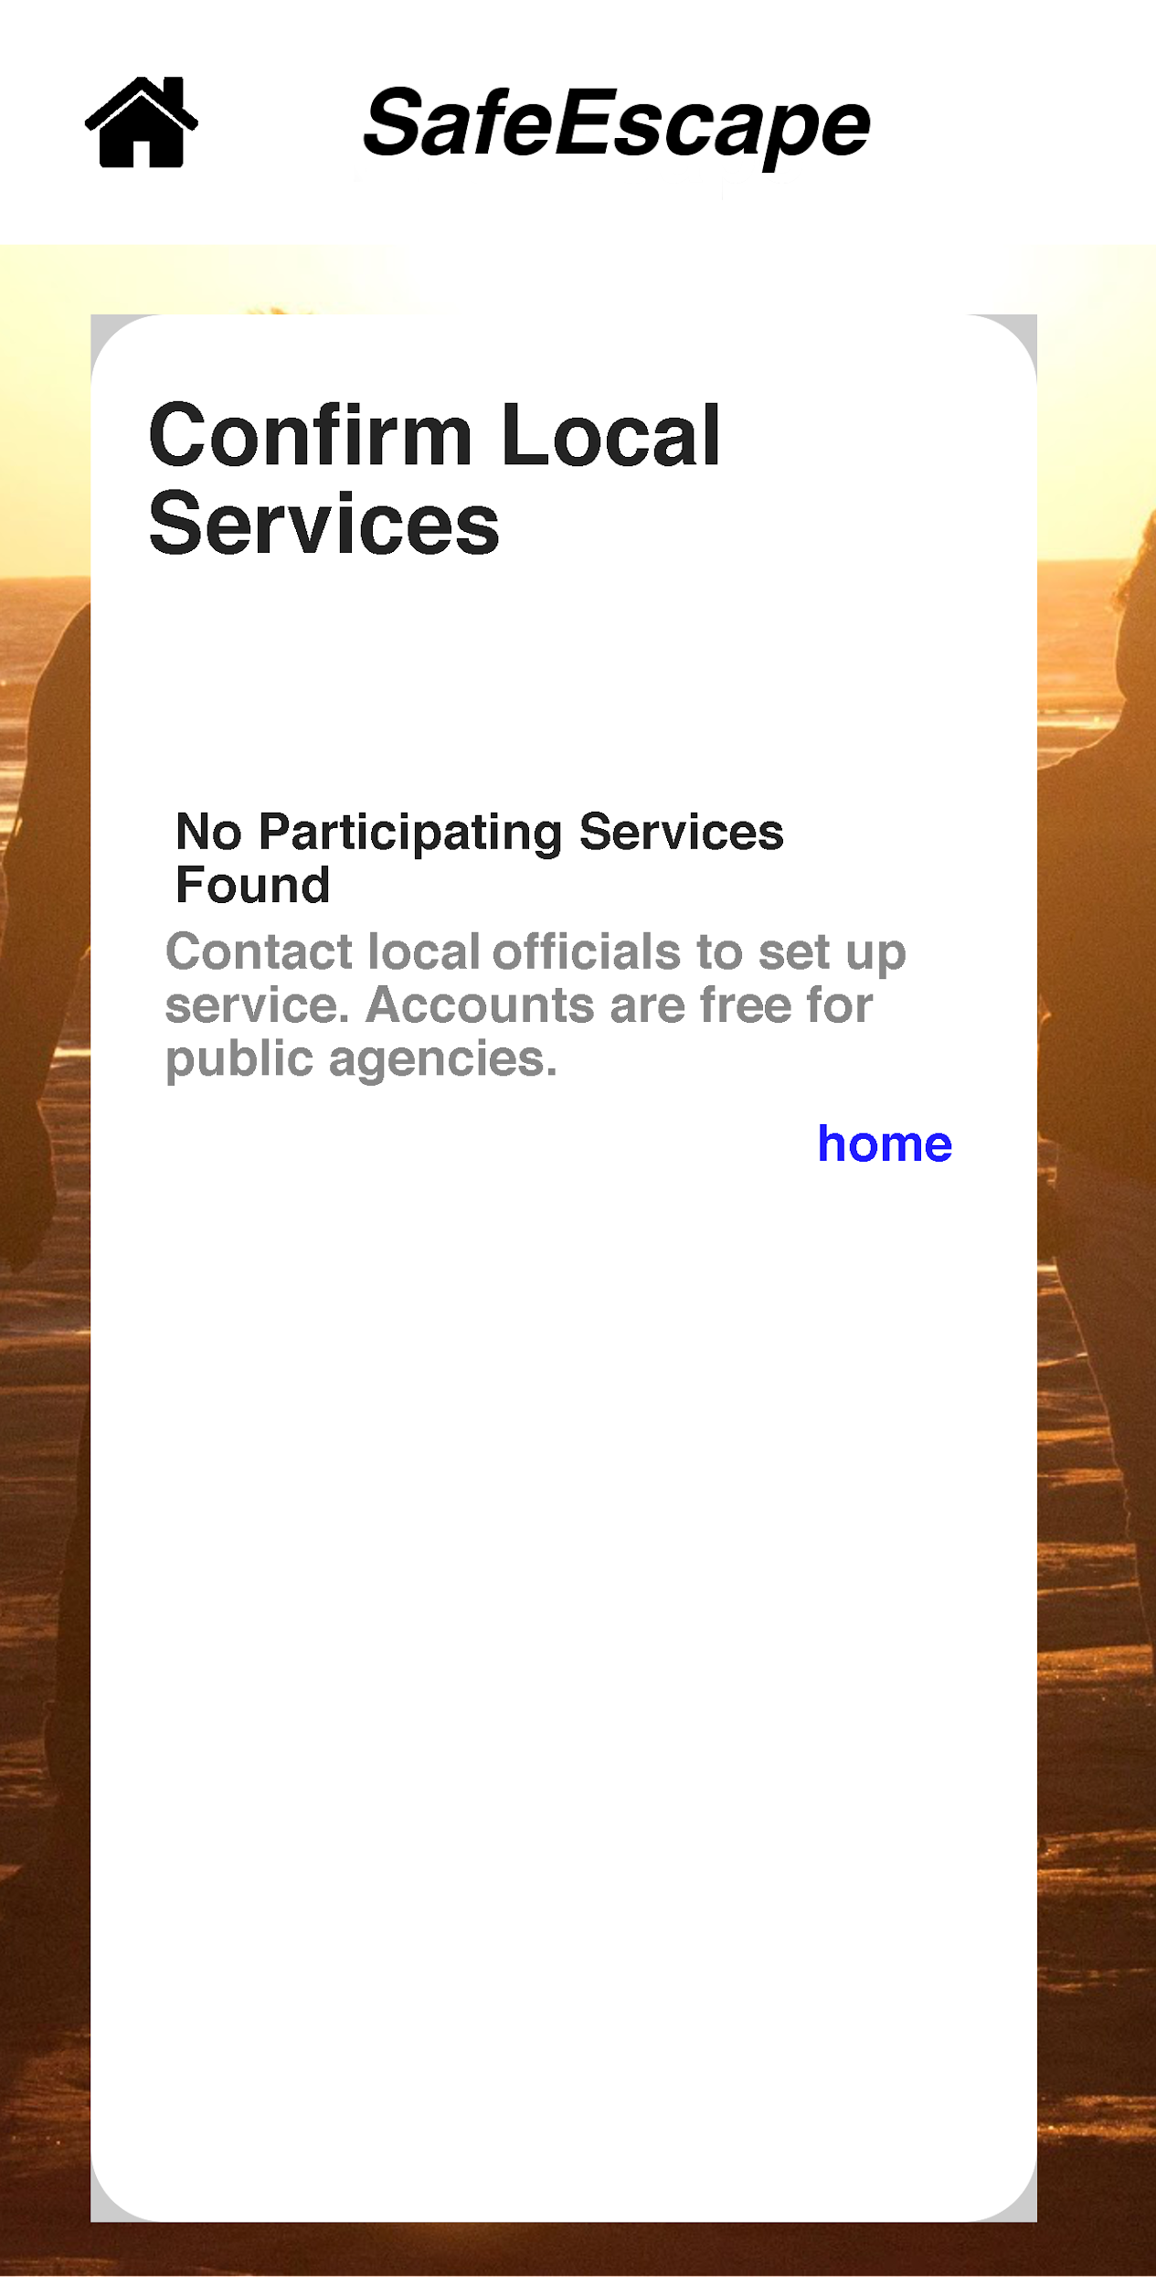
No local services found
Message to contact local officials to sign up for free account.
Return home

Slide 15
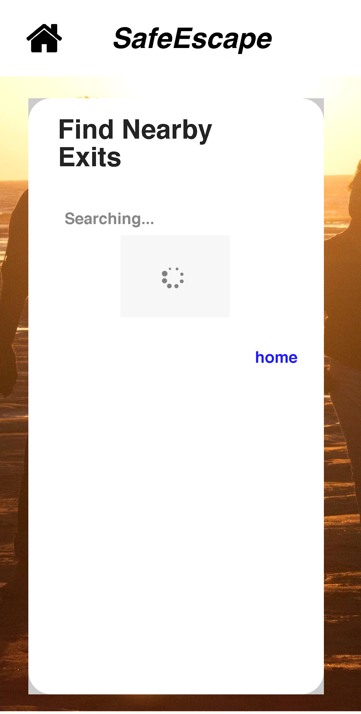
Find nearby exit locations
Uses location services to search for nearest registered exit.
App will either
Find exits
Or find no exits

Slide 16
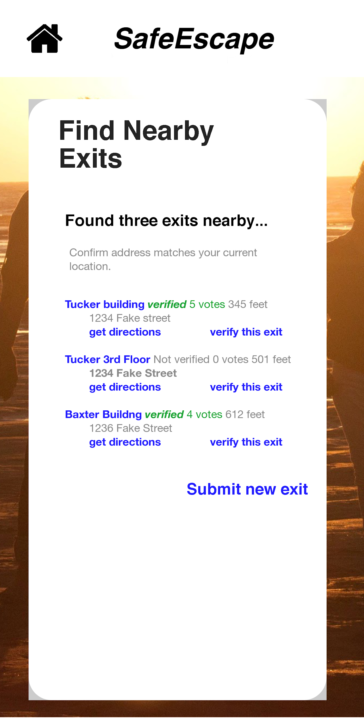
Exit(s) found
Finds nearby exits by location tagged, user confirms address matches, in case the nearest exit is actually in a neighboring building.
Clicking the name of the exit to choose to get directions or vote to confirm it. Alternatively, there are shortcuts to get directions or verify
Additionally, from this screen you can add a new exit

Slide 17
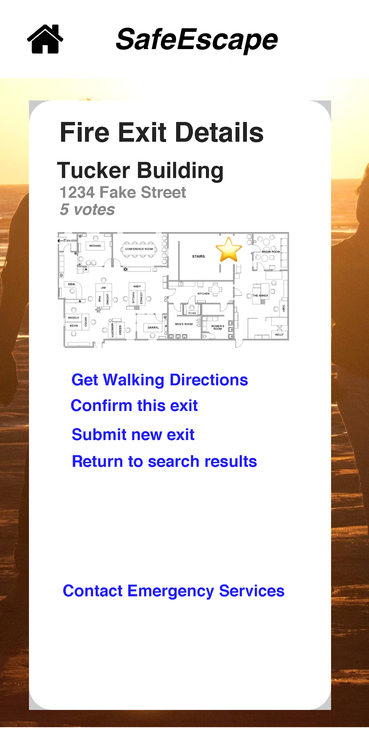
Exit Details
Click for
Walking directions
Confirm this location
Submit a new exit
Contact Emergency Services
Click home to return to home screen

Slide 18
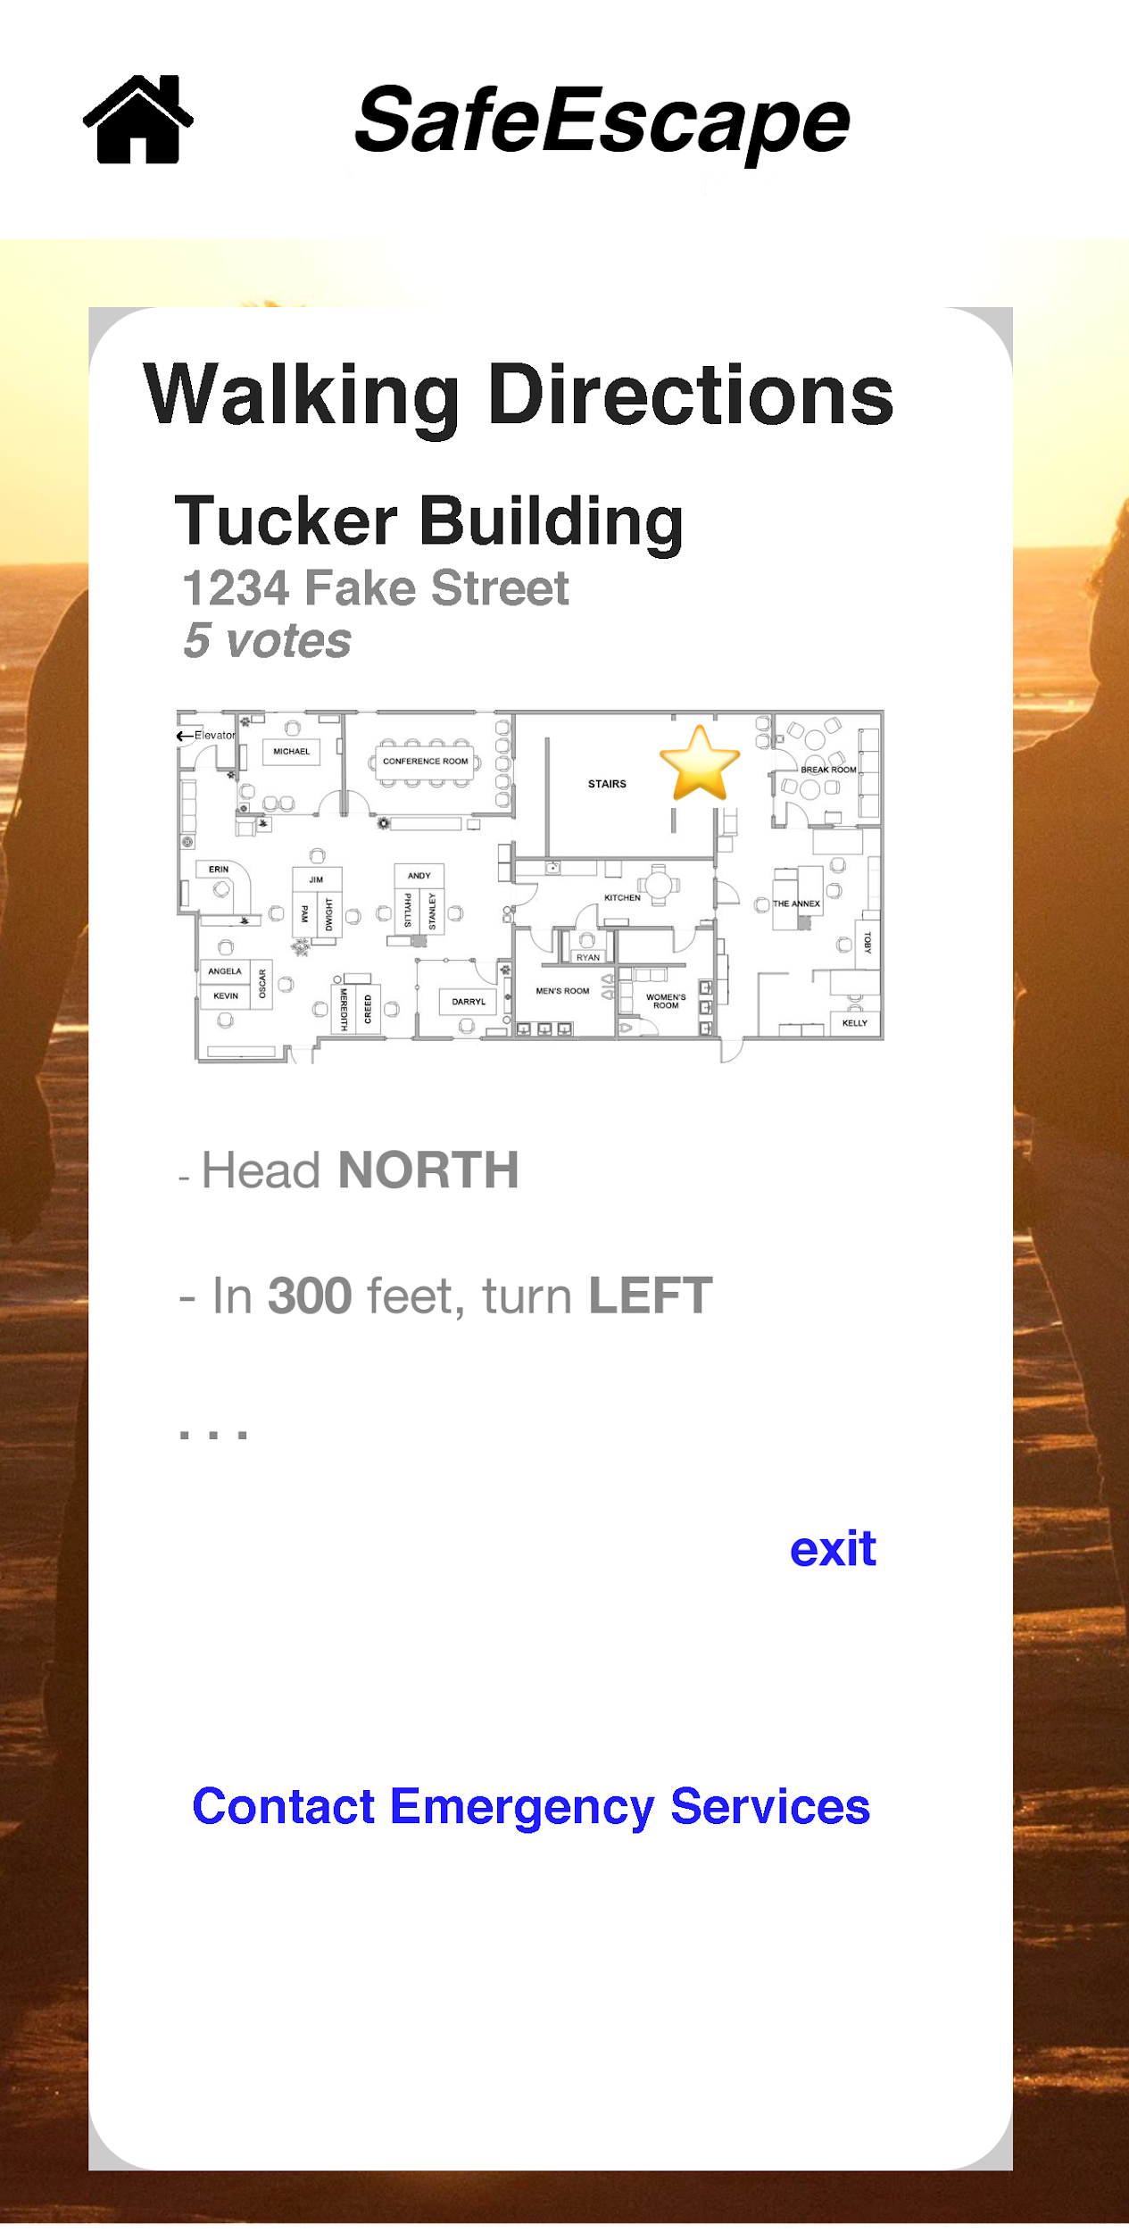
Walking Directions
Text of walking directions updates in real time.
Verbal notifications before every turn.
User can exit directions at any time, returning to the exit details or return to the home screen from the home button

Slide 19
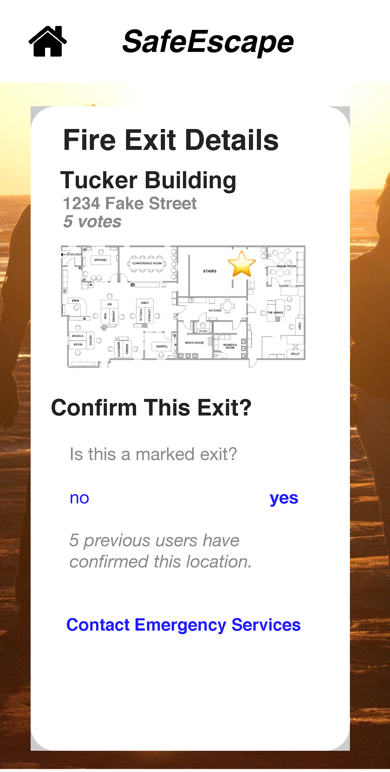
Confirm this location
Is this a marked fire exit?

Slide 20
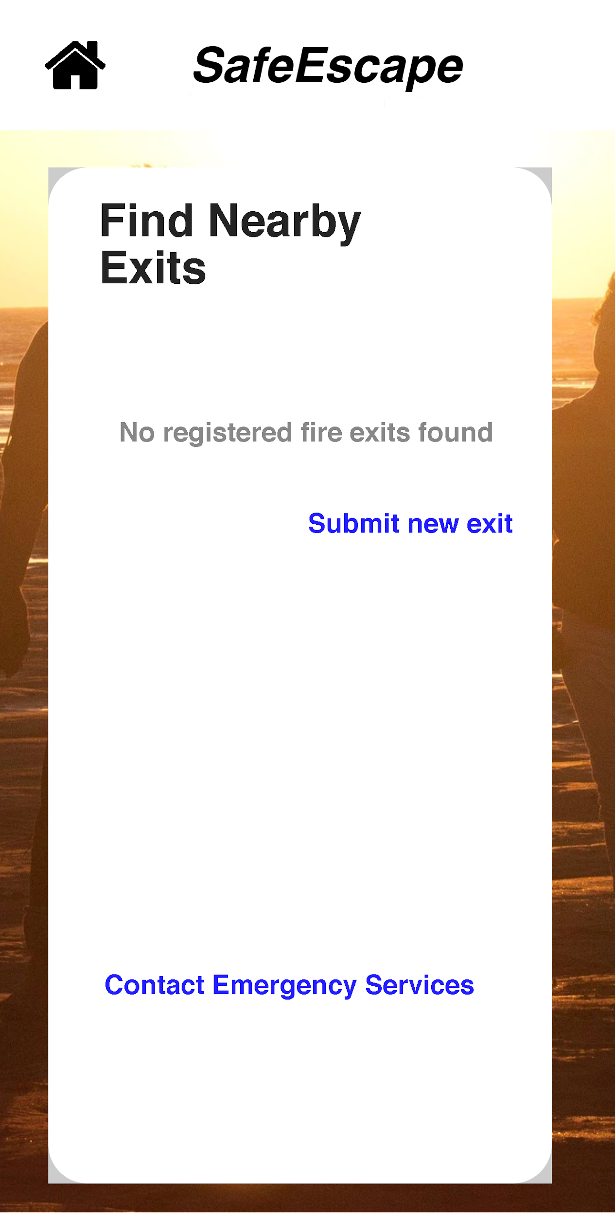
No Exit Found
Click Add New to submit an exit location

Slide 21
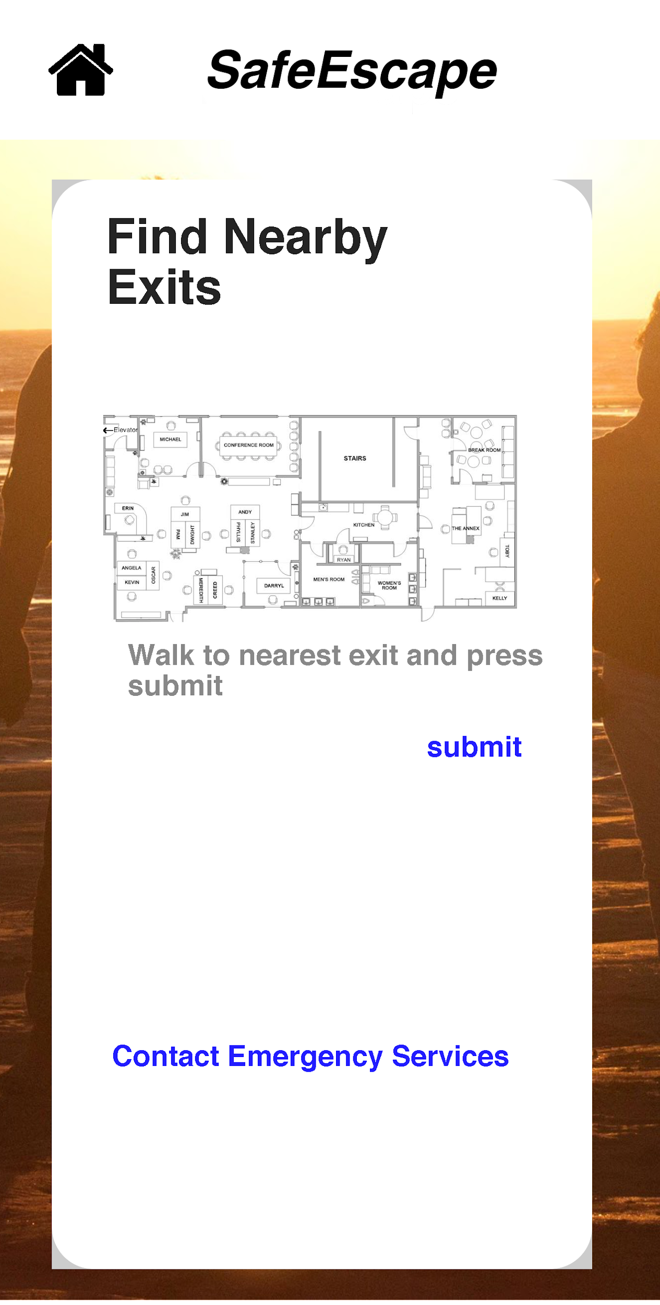
Submit new Emergency Exit location
Select add new
Walk to exit location
Select submit

Slide 22
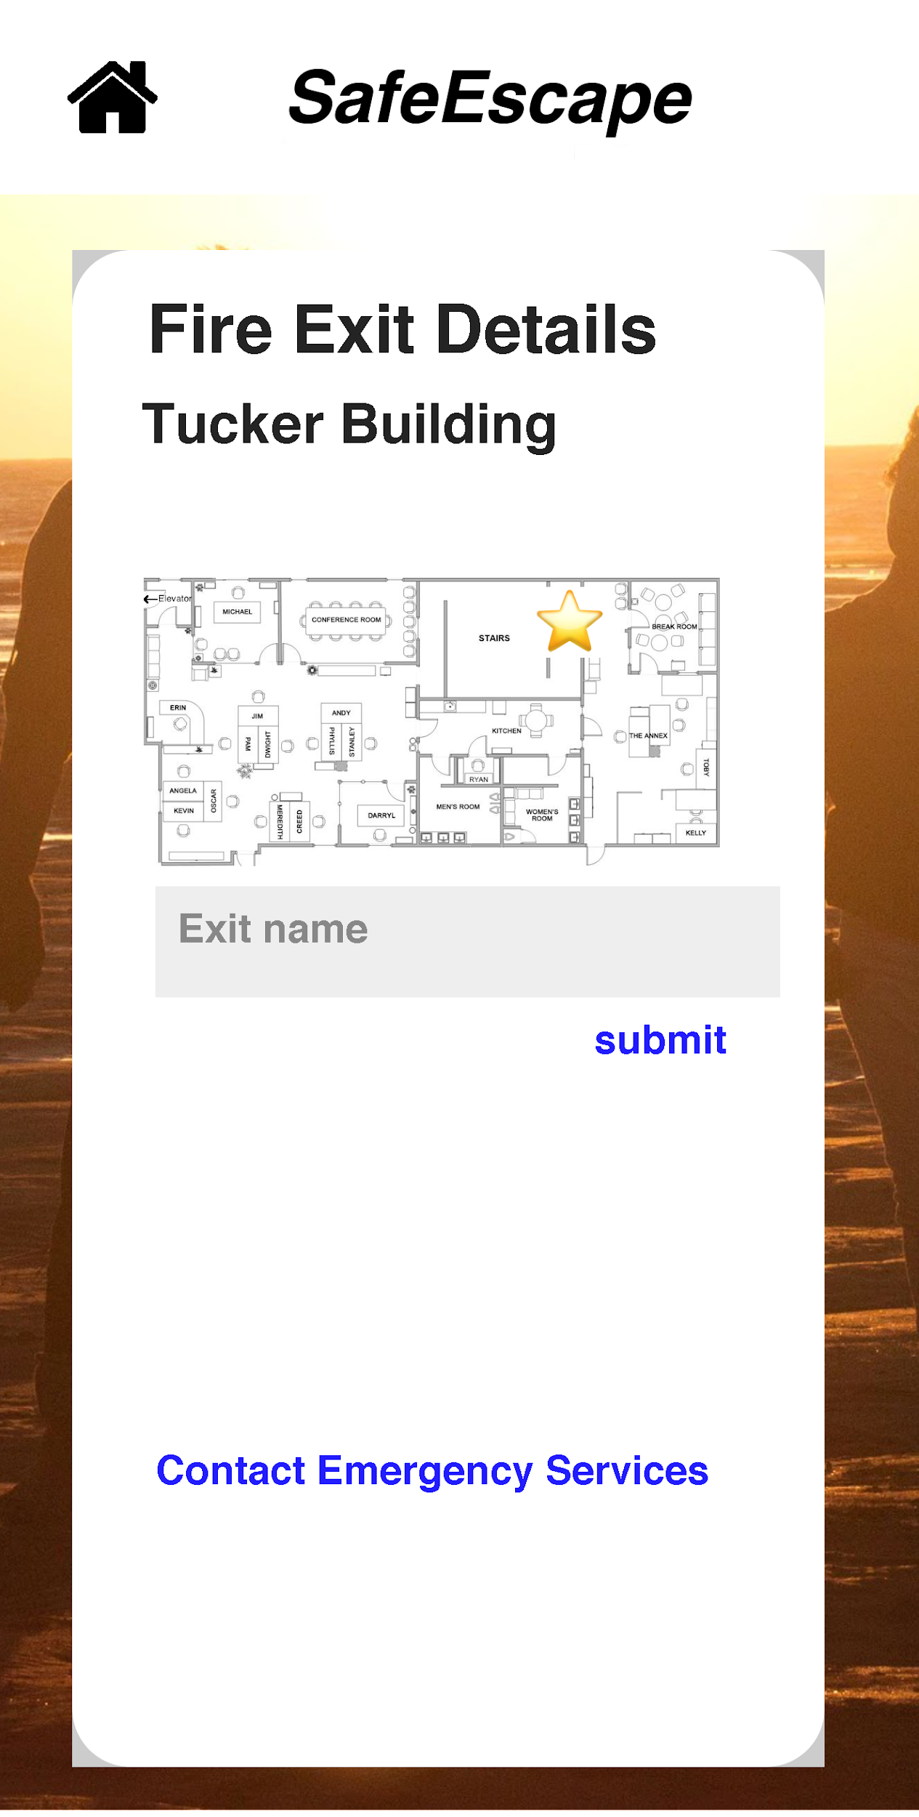
Exit details
Name the exit
Save

Slide 23
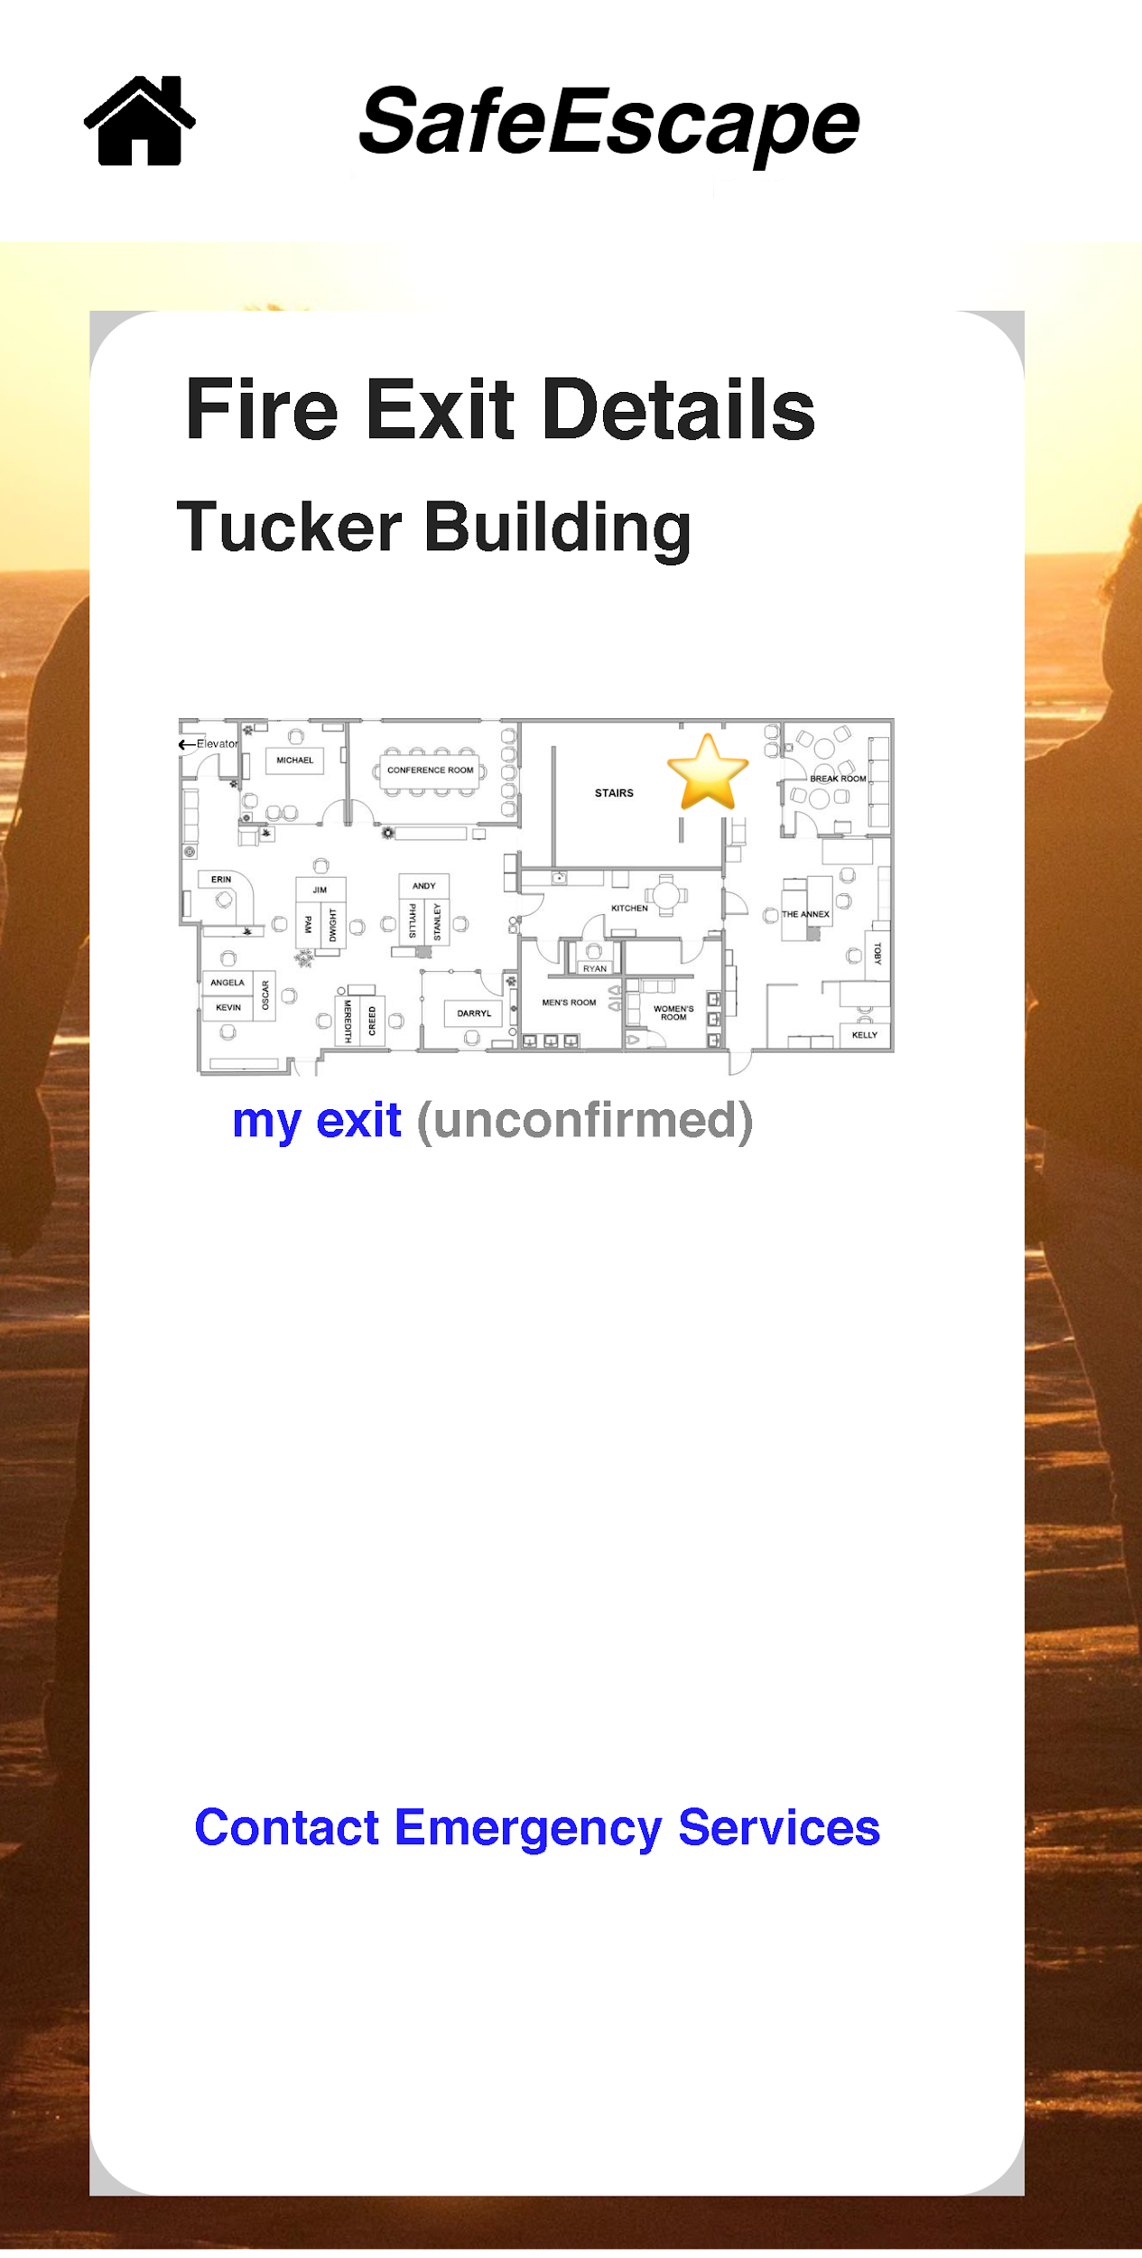
View your exit
It will not have a checkmark until other users confirm it

Slide 24
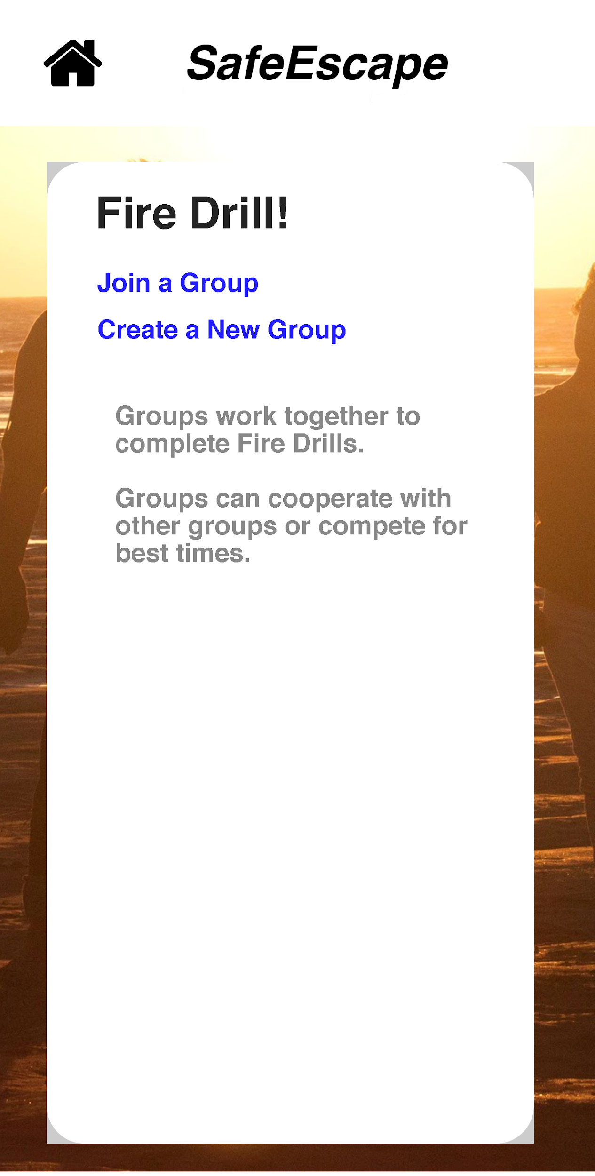
Fire Drill Mode
Join a group
Start a new group

Slide 25
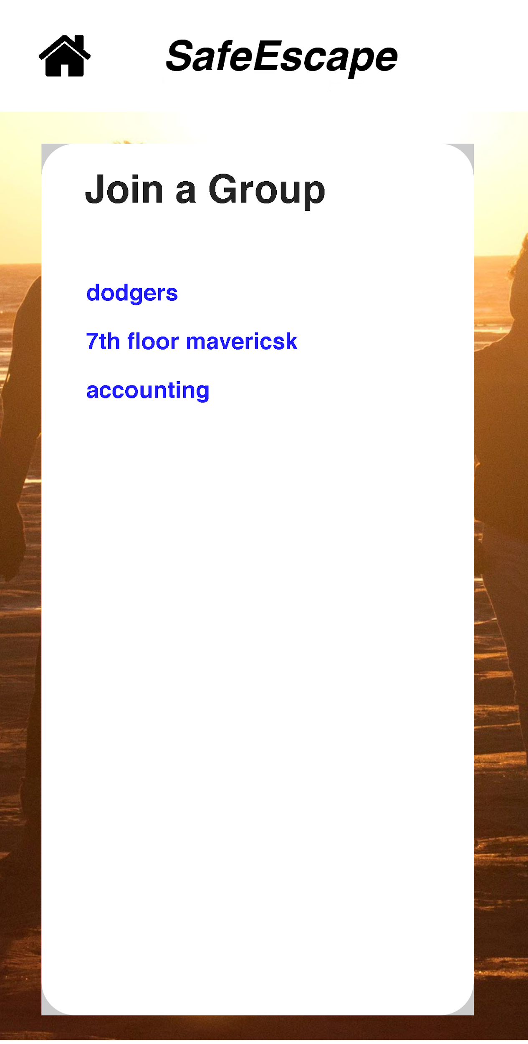
Join Existing Group
Select a group and Start Drill

Slide 26
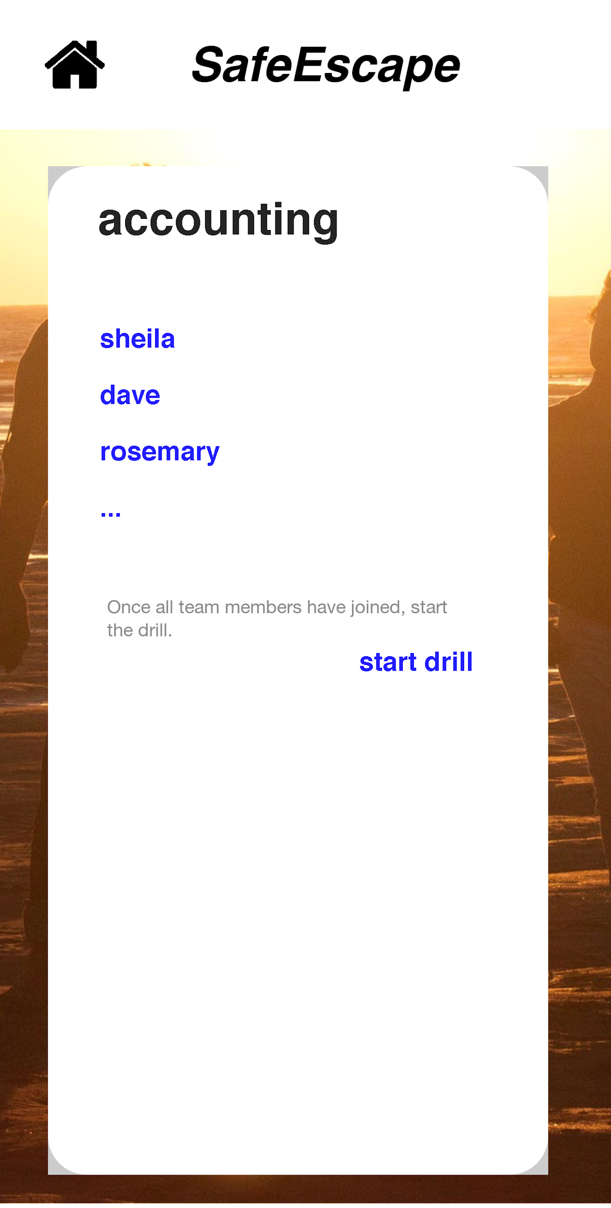
Start the Drill
Once all group members have joined, start the drill

Slide 27
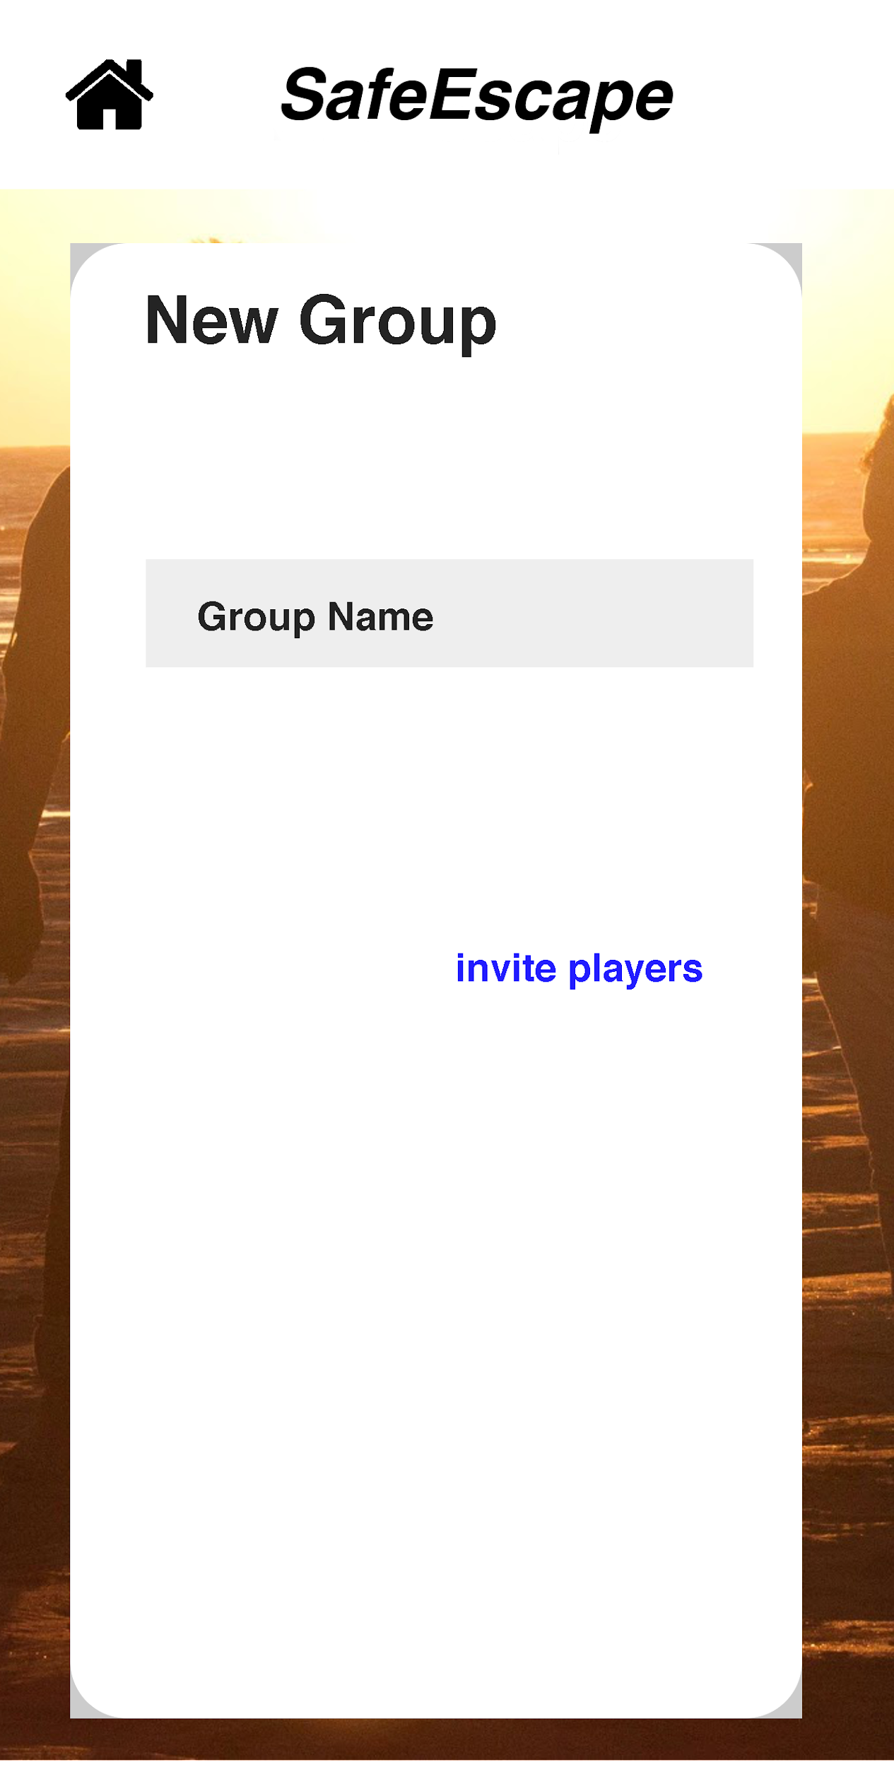
Create a new Group
Name the group and invite players

Slide 28
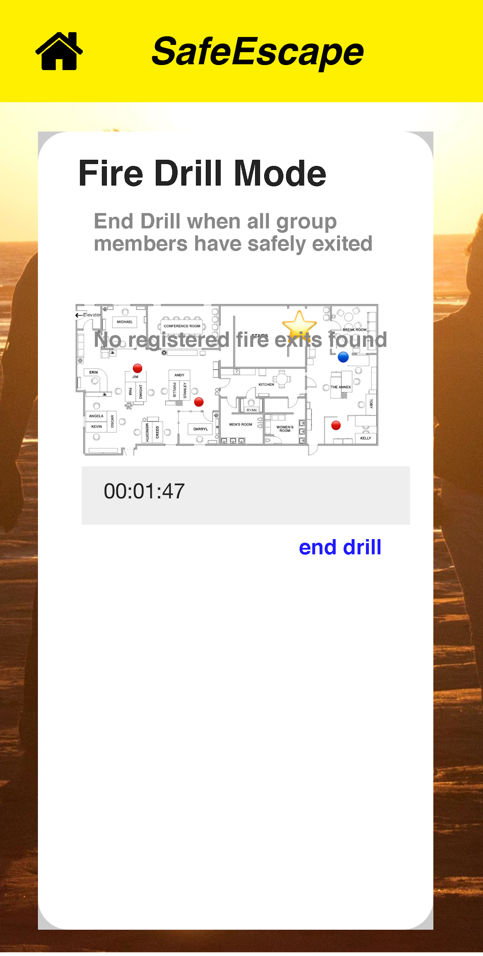
Active Drill Mode
Start the timer and track player progress.

Slide 29
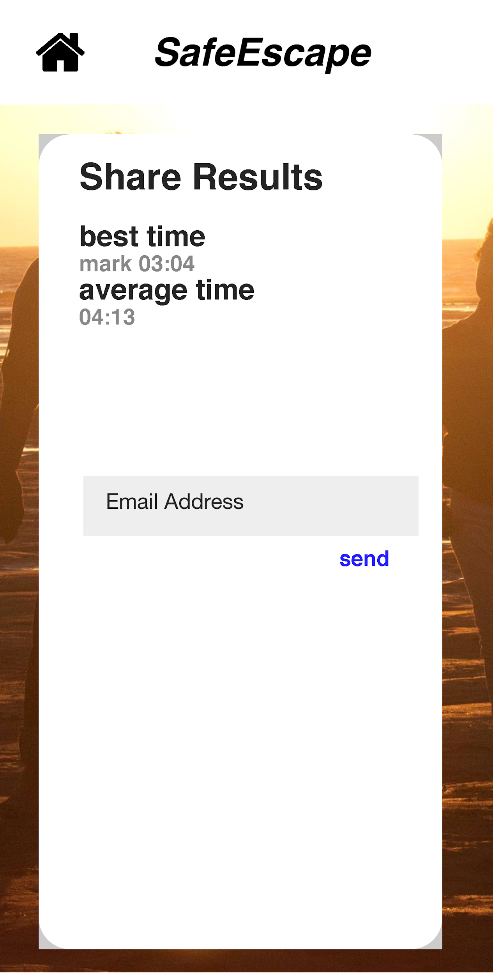
Complete Fire Drill
Share report to an email address
Return home

Slide 30
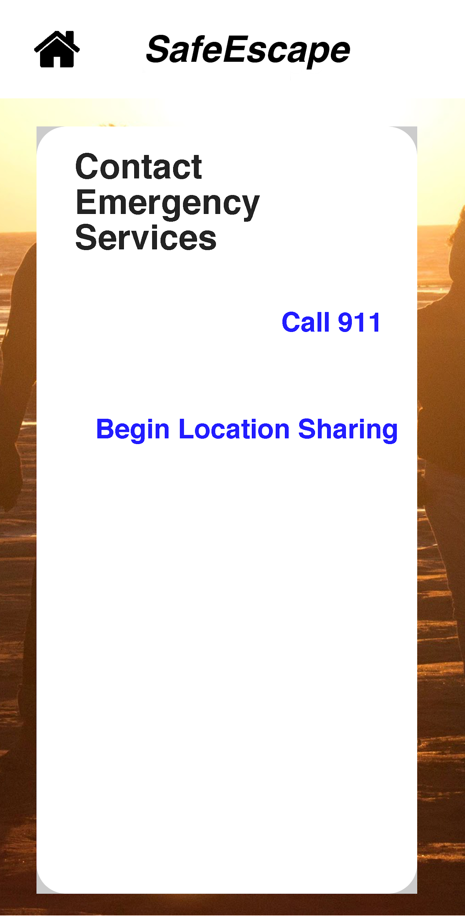
Contact emergency services
During an emergency:
911 button will redirect to phone app to call emergency services
Share location: will active active mode, sending real time data to fire department, who can track users on a map

Slide 31
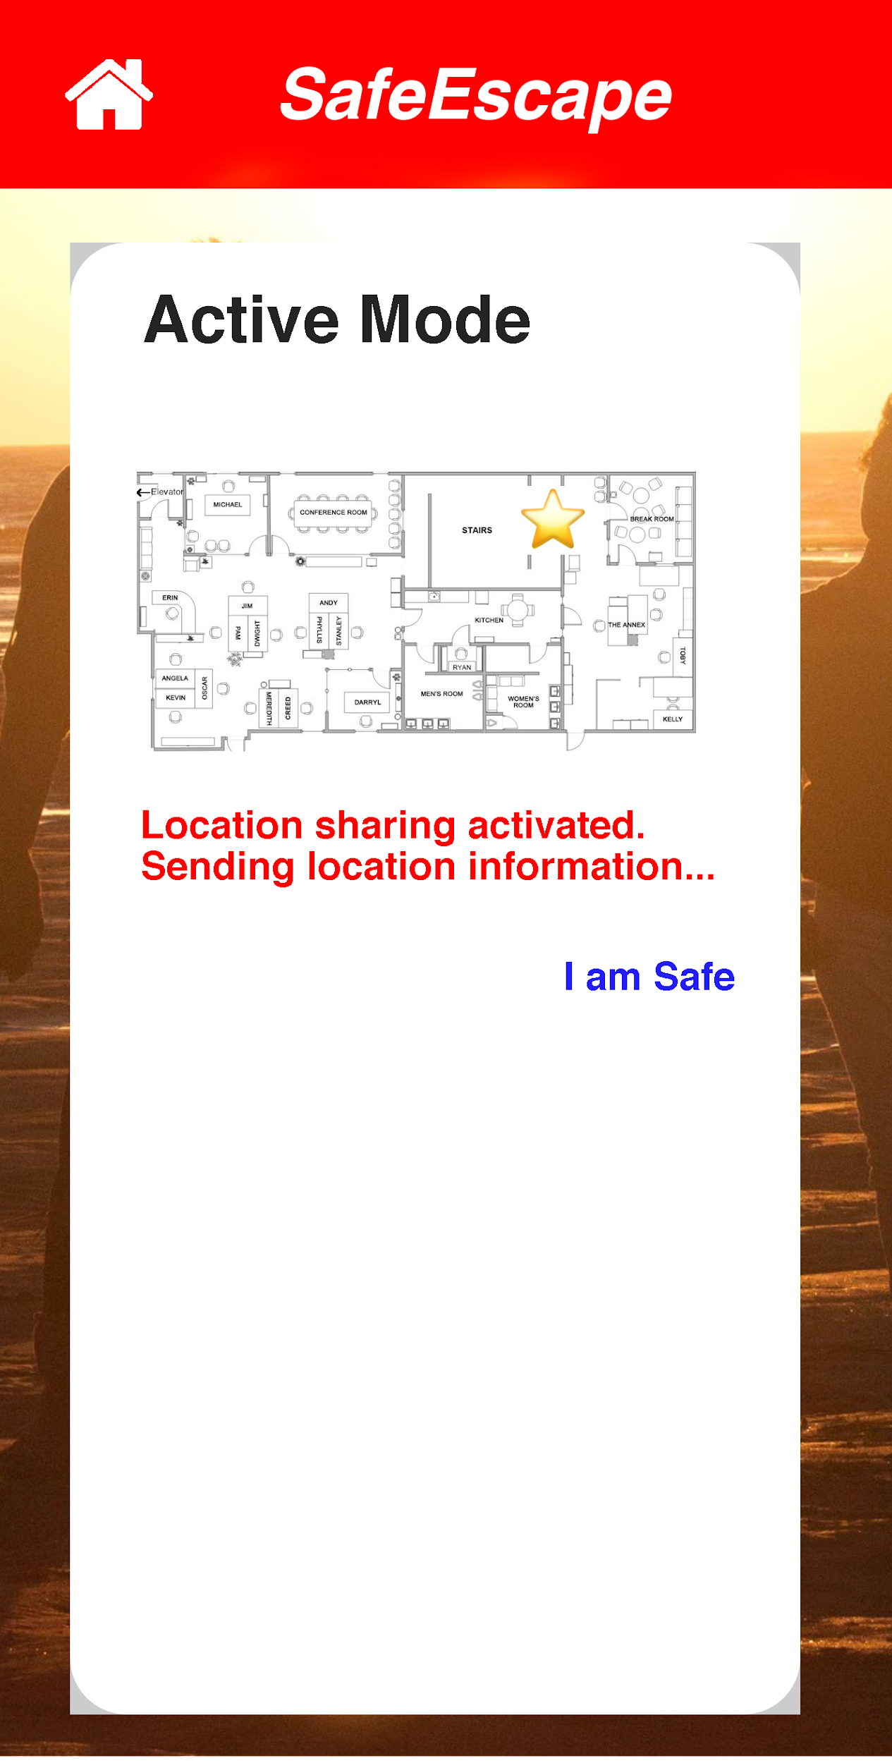
Active mode
Send message to record audio message to share with fire department
I am safe exits active mode and lets fire department know you have exited successfully. App returns to normal functionality.

